Slide 1
Fick’s First Law
of Diffusion
Sergi Valverde
svalver@gmail.com

Slide 2
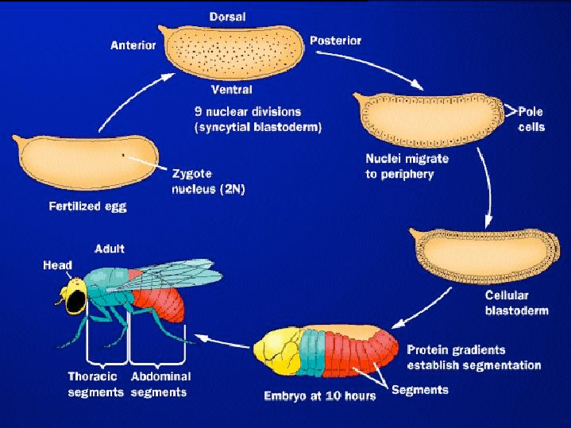
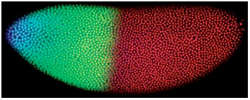
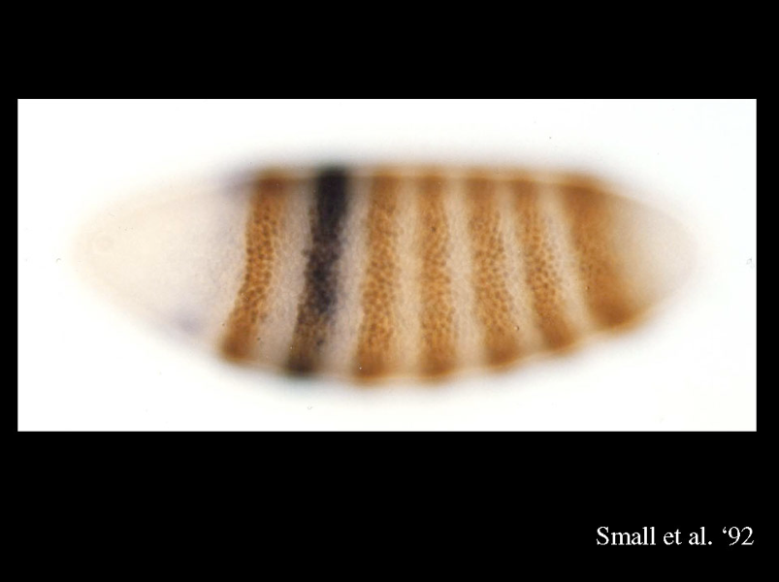
Drosophila Embriology
How identical embrionic cells begin to express different gene products corresponding to different adult body parts?
Notes:
Patterning along the anterior/posterior axis depends on morphogens that diffuse through the common cytoplasm of the syncytial blastoderm.
Drosophila and human development are homologous processes.
They utilize closely related genes working in highly conserved regulatory networks. Unlike humans, Drosophila is subject to easy genetic manipulation. As a result, most of what we know about the molecular basis of animal development has come from studies of model systems such as Drosophila.
http://en.wikipedia.org/wiki/Morphogenesis
Drosophila embryogenesis - Wikipedia, the free encyclopedia
http://en.wikipedia.org/wiki/French_flag_model
The French Flag model was championed by the leading Drosophila biologist, Peter Lawrence. Christiane Nüsslein-Volhard identified the first morphogen, Bicoid, one of the transcription factors present in a gradient in the Drosophila syncitial embryo. Two labs, that of Gary Struhl and that of Stephen Cohen, then demonstrated that a secreted signaling protein, Decapentaplegic (the Drosophila homologue of Transforming Growth Factor Beta), acted as a morphogen during later stages of Drosophila development. substance governing the pattern of tissue development and, in particular, the positions of the various specialized cell types within a tissue. It spreads from a localized source and forms a concentration gradient across a developing tissue.
http://www.youtube.com/watch?v=uaedzlrnBGY&feature=related

Slide 3
Patterning Development in the Embryo
Bicoid Protein
Gradient in the Embryo
Expression Pattern
Bicoid protein
(synthesized by mother)
Bicoid conc.
x
Anterior
Posterior
Notes:
http://www.youtube.com/watch?v=uaedzlrnBGY&feature=related
The Bicoid mRNA, which is synthesized in mothers and deposited in the oocyte, is localized in the anterior pole of the early fly embryo.

Slide 4
Patterning Development in the Embryo
Bicoid Protein
Gradient in the Embryo
Expression Pattern
Bicoid input
Bicoid conc.
x
Spatial distribution of expressed Hunchback protein parallels that of the Bicoid protein gradient
Bicoid
Hunchback
Notes:
LEFT: Once Bicoid (Bcd) protein is synthesized at the anterior end of the embryo, it diffuses posteriorly forming a protein gradient.
RIGHT: The graded concentration of protein Bicoid along the length of the embryo (according to Fick’s First Law) determines the region in which the hunchback gene is transcribed in the zygote. The spatial distribution of expressed Hunchback protein parallels that of the Bicoid protein gradient.
FICK’S LAW: if you have a high concentration of something it goes to low concentration.
http://www.youtube.com/watch?v=Hmfnolr47Zw

Slide 5
Patterning Development in the Embryo
Bicoid Protein
Gradient in the Embryo
Expression Pattern
Hunchback
protein
Bicoid conc.
x
High [Hunchback]
Krüpple transcription repressed
Bicoid
Hunchback
Krüpple
Notes:
Hunchback protein regulates expression of several gap genes. Hunchback protein functions as both transcription repressor ( left) or activator (middle), is a morphogen that regulates transcription of the Krüpple gene.
At high concentrations, Hunchback protein represses Krüpple.

Slide 6
Patterning Development in the Embryo
Bicoid Protein
Gradient in the Embryo
Expression Pattern
Hunchback
protein
Bicoid conc.
x
[Hunchback] < threshold 1
Threshold 1
Krüpple transcription activated
Bicoid
Hunchback
Krüpple
Notes:
Below a critical threshold concentration, Hunchback protein no longer represses Krüpple, but instead acts as a transcriptional activator.

Slide 7
Patterning Development in the Embryo
Bicoid Protein
Gradient in the Embryo
Expression Pattern
Hunchback
protein
Bicoid conc.
x
[Hunchback] < threshold 2
Threshold 2
Krüpple transcription not activated
Bicoid
Hunchback
Krüpple
Notes:
The second threshold sets a posterior boundary below which Hunchback protein no longer activates Krüpple.

Slide 8
Patterning Development in the Embryo
Protein Gradient
in the Embryo
Expression Pattern
Krüpple
protein
Protein conc.
x
Band detector: morphogen gradient encodes position
Threshold 1
Threshold 2

Slide 9
Fick’s Law of Diffusion
Bicoid input
High [A]
Concentration
Low [B]
Concentration
Hunchback
protein
z
n
∂ n
A
A
=
flow
=
J
=
-D
Area × time
A
AB
z
∂ z
Notes:
CHECK THIS VIDEO: http://www.youtube.com/watch?v=Hmfnolr47Zw
- If you have a high concentration of something it goes to low concentration. Fick’s law of diffusion describes just that.
#A /area x time = is the number of A particles ( Hunchback protein) crossing an area ( vertical line) per time.
We call this quantity Flux (flow) ) J_A_z. A represents whatever is crossing it. The z means going in this direction (horizontal from left to right, check slide).
We can make an equation for the flux. it is equal to the negative coefficient of diffusion D_{AB} A is the orange balls and B is the blue balls) TIMES the changing concentration of A (delta N_A) per change in the Z-direction.
- “Diffusion is the net flux of particles down a concentration gradient due to random movement”
- Although the motion of individual particles is totally random with respect to the direction, it may happen that particles walk somewhat far relative to a starting point. In a normal flow, all particles under investigation move more or less into the same direction. This is a consequence of an heterogenous distribution: in crowed places, particles have more obstacles and they cannot move freely as in less crowed places.
For example, open a container with dye within an aquarium. After a while, you will find the dye spread around all available water. When you this experiment, you will see, that it takes a lot of time until you have a uniform color. This is typical of the underlying random mechanism. The dye particles move forth, back, back, forth , back, forth, forth, forth, back... and this takes time. This slowliness is typical of diffusion.
http://www.youtube.com/watch?v=uaedzlrnBGY&feature=related

Slide 10
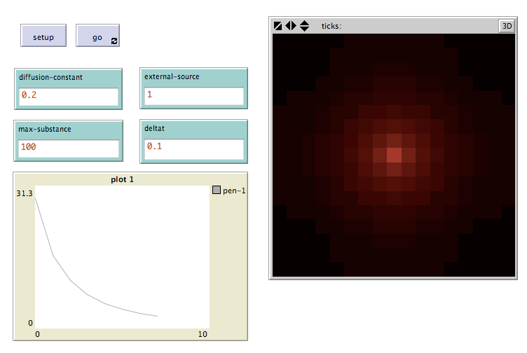
Pràctica 1

Slide 11
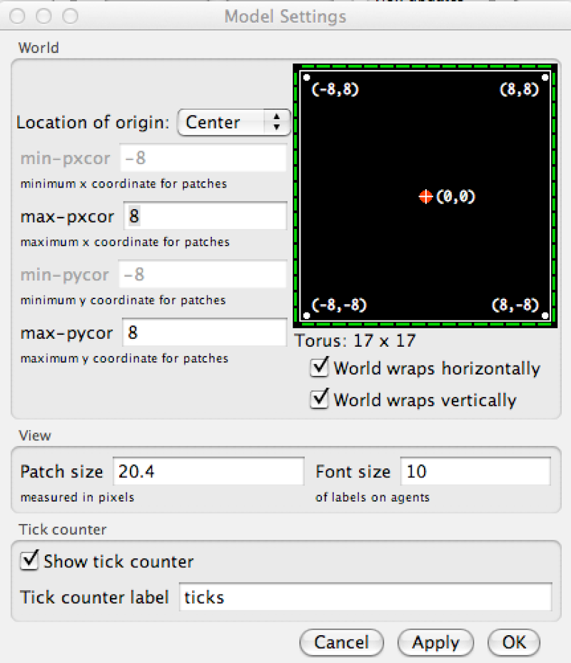
Dimensions de l’àrea de simulació

Slide 12
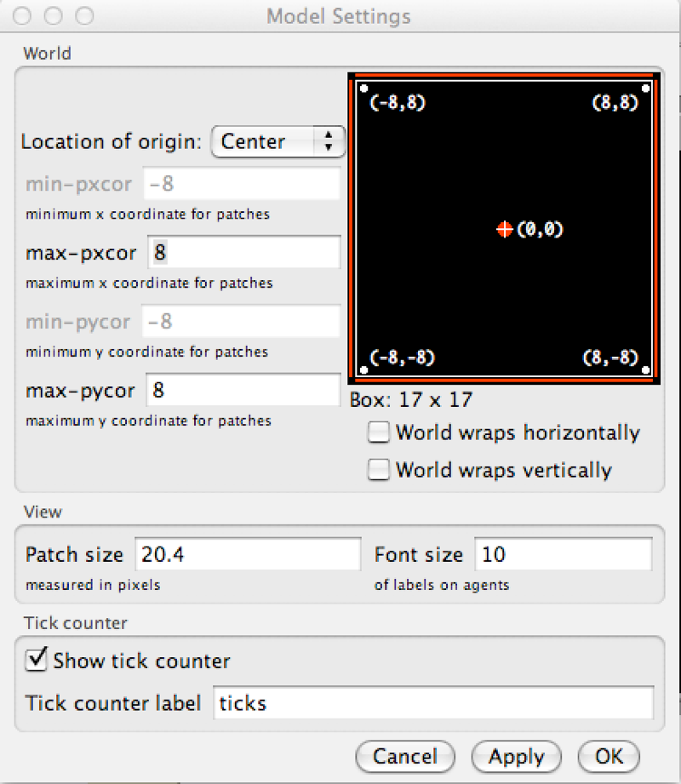
Condicions de Contorn

Slide 13
Apartat 1: Programar en Netlogo la difusió i la llei de Fick (amb condicions de contorn)
Apartat 2: Estudiar la difusió quan es desactiven condicions de contorn.
Apartat 3: Simular la segmentació simple pintant en vermell patches amb concentració mes gran que un cert llindar (substance >= threshold). Provar diferents thresholds.

Slide 14
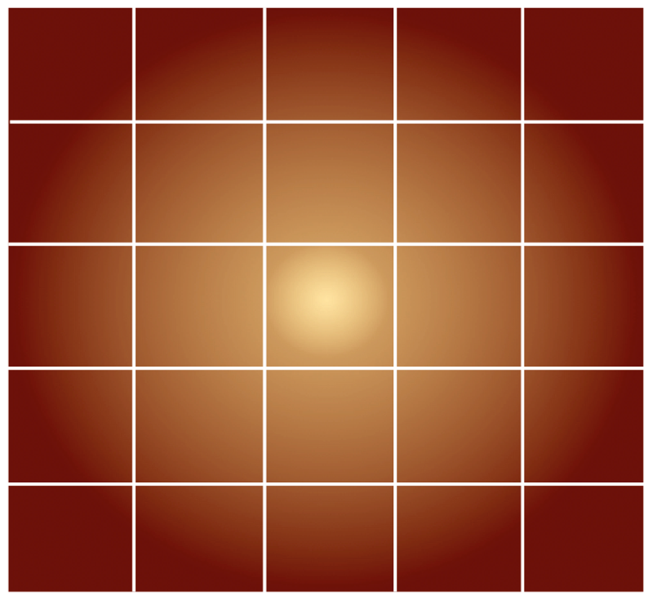

patches-own
patches-own [substance]

Slide 15
Accessing Patches (1)
x
patch x y
y
[substance] of patch 0 0
Notes:
patch-at 0 -1: retorna el patch situat a sobre del patch
[substance] of patch-at 0 -1: retorna la quantitat de substancia en el patch indicat

Slide 16


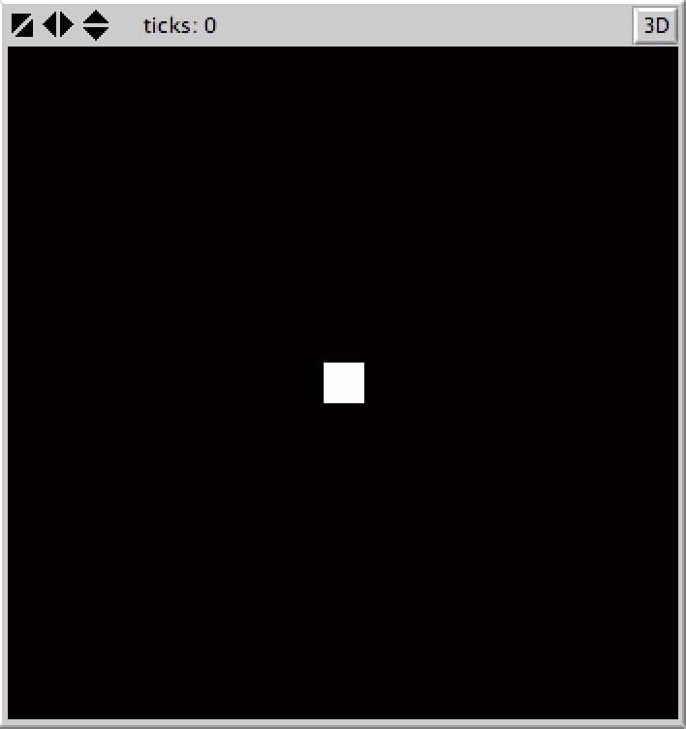
Apartat 1
patches-own [ substance deltax deltay ]
to setup
clear-all
ask patch 0 0
[
set substance max-substance
]
ask patches
[
set pcolor scale-color red substance 0 max-substance
]
end
Notes:
- set initial concentration of substance at the center of the screen
- max-substance is a parameter
- patch color is proportional to the local concentration

Slide 17

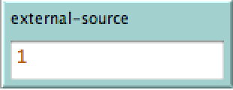
to go
ask patch 0 0
[
set substance substance + external-source
]
ask patches
[
set pcolor scale-color red substance 0 max-substance
]
end
Notes:
- external-source is another parameter

Slide 18
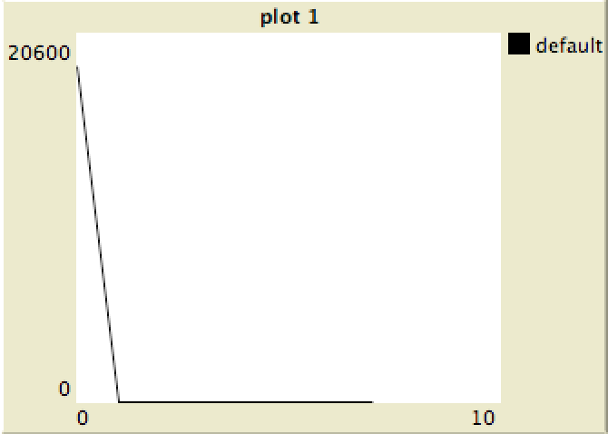
to go
ask patch 0 0
[
set substance substance + external-source
]
ask patches
[
set pcolor scale-color red substance 0 max-substance
]
clear-plot
let i 0
while [ i < max-pxcor ]
[
plotxy i [substance] of patch i 0
set i i + 1
]
end
Notes:
- external-source is another parameter

Slide 19
to go
diffusion
ask patch 0 0
[
set substance substance + external-source
]
ask patches
[
set pcolor scale-color red substance 0 max-substance
]
clear-plot
let i 0
while [ i < max-pxcor ]
[
plotxy i [substance] of patch i 0
set i i + 1
]
end
Notes:
- external-source is another parameter

Slide 20
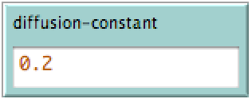
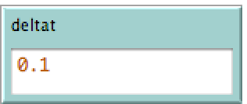
to diffusion
; Implementar la llei de Fick per simular la difusió de
; la ‘substance‘. ; Actualitzar les variables ‘substance’ dels
; patches. Fer servir els parametres ‘diffusion-constant’ i
; ‘deltat’
end

Slide 21

Fick’s First Law of Diffusion
Diffusion
Constant
Flow
Gradient
Notes:
D: coefficient de difusió de l’especie de concentració C.
Si el sistema esta en el equilibrio

Slide 22


Fick’s Second Law of Diffusion
Notes:
Fick’s first law can be used to derive his second law which in turn is identical to the diffusion equation.
D: coefficient de difusió de l’especie de concentració C.
Si el sistema esta en el equilibrio

Slide 23



Numerical integration of Fick’s Law (Euler’s method)

Slide 24
Numerical integration of Fick’s Law
x
y

Slide 25
Numerical integration of Fick’s Law
x
y

Slide 26

Numerical integration of Fick’s Law
x
y

Slide 27

Numerical integration of Fick’s Law
x
y
y

Slide 28
Accessing Patches (2)
0, 1
patch-at dx dy
patch-at 0 -1
-1, 0
1, 0
[substance] of patch-at 0 -1
0, -1
Notes:
patch-at 0 -1: retorna el patch situat a sobre del patch
[substance] of patch-at 0 -1: retorna la quantitat de substancia en el patch indicat

Slide 29


to diffusion
ask patches
[
; per a cada patch (x,y) calcular el seu deltax i deltay
]
ask patches
[
; integrar la concentracio
]
end

Slide 30
to diffusion
ask patches
[
; per a cada patch (x,y) calcular el seu deltax i deltay
]
ask patches
[
; integrar la concentracio
]
end

Slide 31
Apartat 1: Programar en Netlogo la difusió i la llei de Fick (amb condicions de contorn)
Apartat 2: Estudiar la difusió quan es desactiven condicions de contorn.
Apartat 3: Simular la segmentació simple pintant en vermell patches amb concentració mes gran que un cert llindar (substance >= threshold). Provar diferents thresholds.

Slide 32
Fin

Slide 33
Accessing Patches (3)
(patch-set patch-at 0 -1 patch-at 0 1)
0.6
[substance] of (patch-set patch-at 0 -1 patch-at 0 1)
[ 0.6 , 2.4 ]
sum [substance] of (patch-set patch-at 0 -1 patch-at 0 1)
2.4
3.0

Slide 34
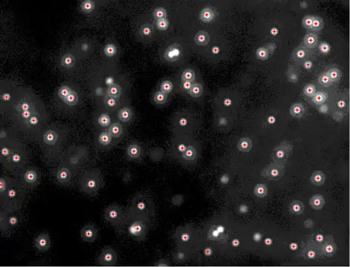
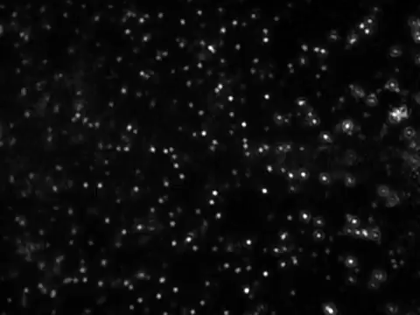
Diffusion is Random Motion
Tracking of 1 µm polystyrene spheres in an enclosed volume
Notes:
- Diffusion is random motion: The average of walked distance of all particles within a random walk (or Brownian motion) is zero: while one particle moves into this direction, another moves into another direction.
They filmed Brownian motion, random movement of particles in water, using a laser unit and a camera with a nanosight adapter, mounted on an optical microscope. The old movie showed 3.2 micron diameter silica (glass) spheres in water, over 10 seconds. Note the incessant, random Brownian motion. Uploaded for Physics 171: The Physics of Life (http://physics.uoregon.edu/~raghu/TeachingFiles/PHYS%20171%20Physics%20of%20Lif­e%20expanded%20description.pdf)

